Slide 1
SPortsMAte Find your Sports Partners
Jianrui Hu
Dec 13 2019

Slide 2
Motivation – I like Sports
Exercise bring a better lifestyle
Sports bring new friends
People more rely on social medial
Hard to find people with same hobby nearby
Hard to find people with same skill level
Hard to find people fit schedule
SportsMate CAN HELP

Slide 3
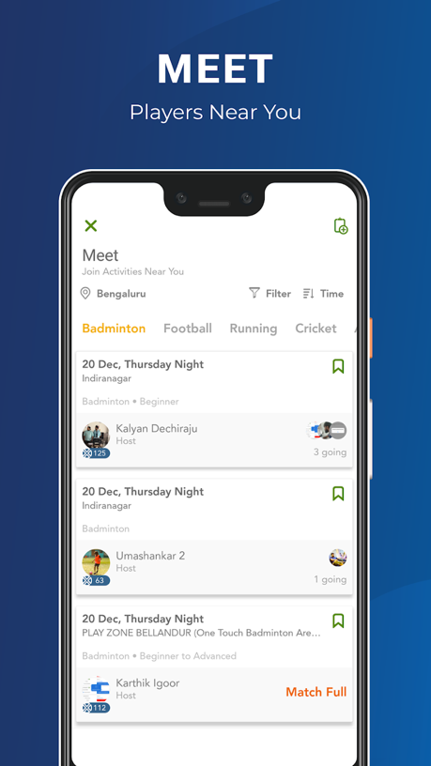
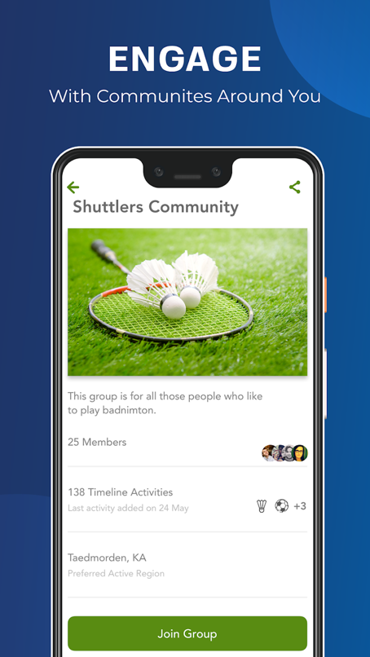
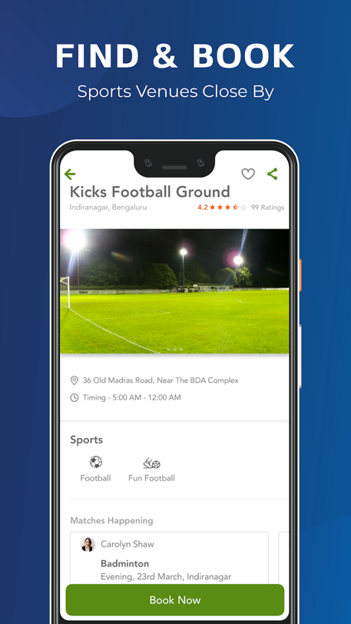
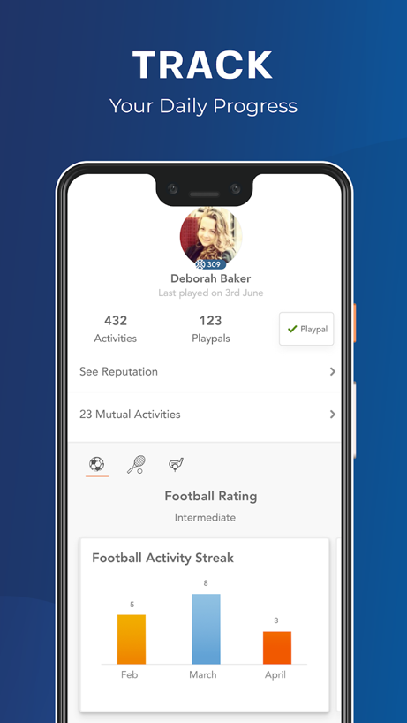
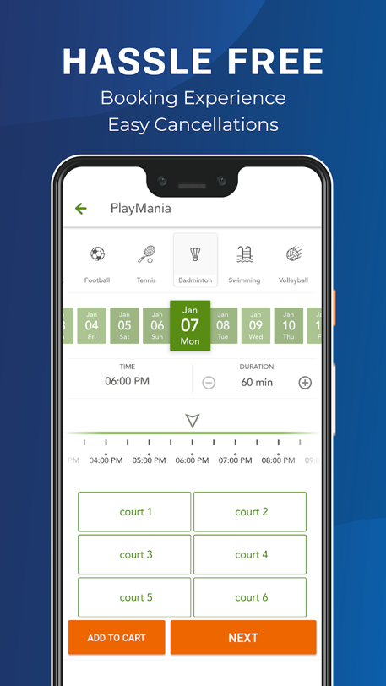
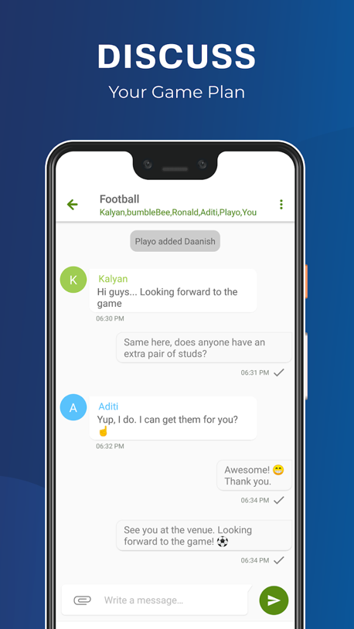
Existing Application - playo
Find partners for badminton, tennis, basketball and other fifty-nine sports
Built-in social features for discussion
Over 500k installs and rate 4.1 out of 5.0
An excellent application

Slide 4
Description – Pose your Ticket
Create account with email address and password
Create personal profile with sports type and skill level
Pose your ticket with your schedule
Show all the ticket with your interest
Pick the ticket and make a match
Go and have fun

Slide 5
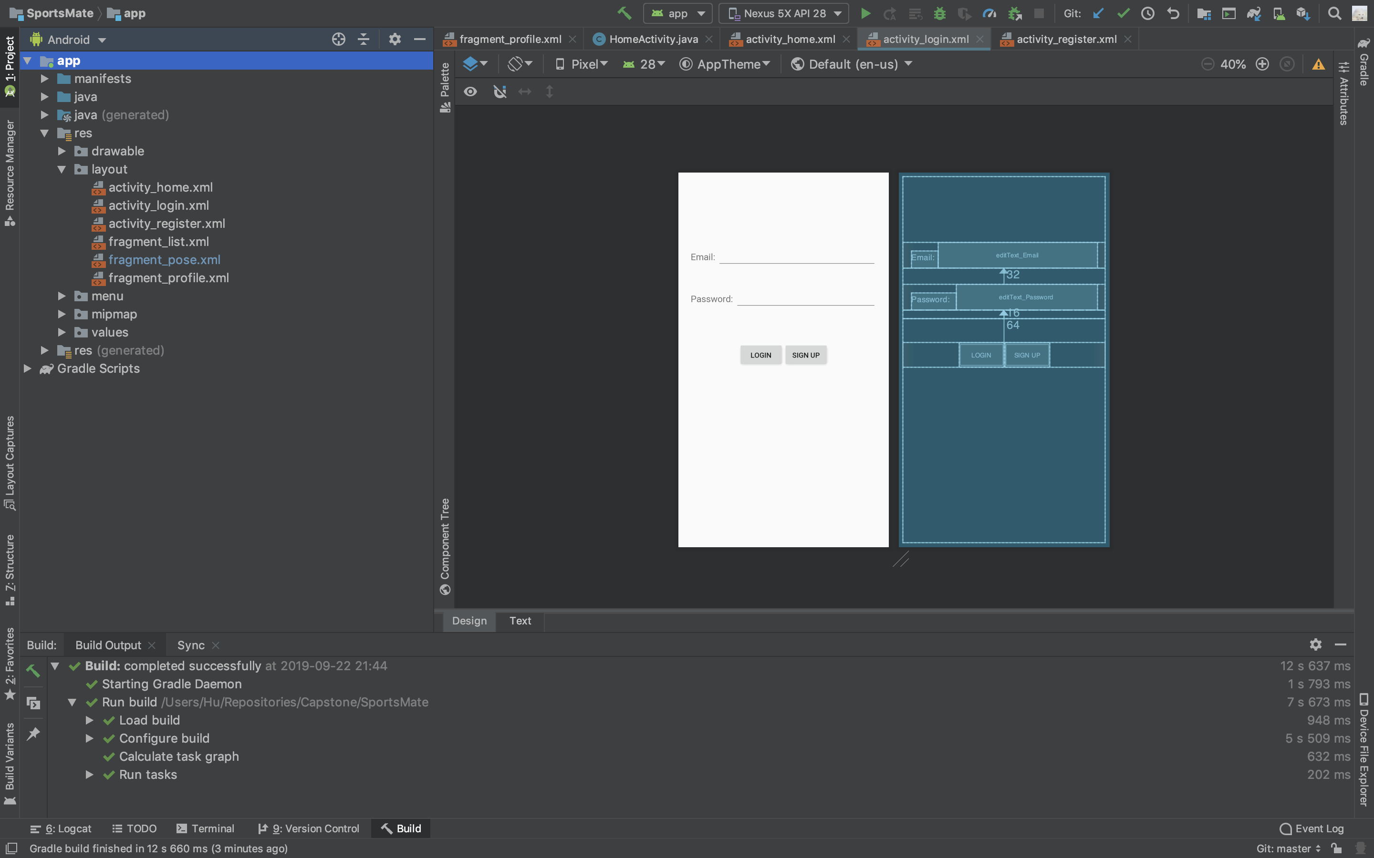
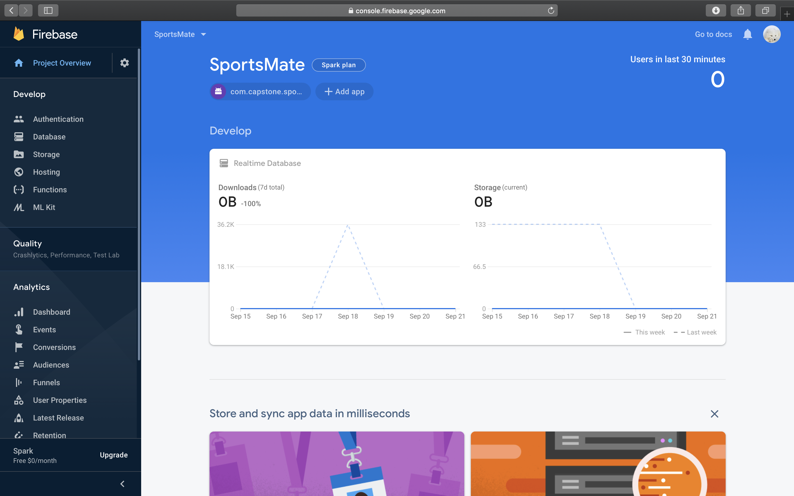
Tools
Frontend: Android Studio
Backend: Firebase

Slide 6
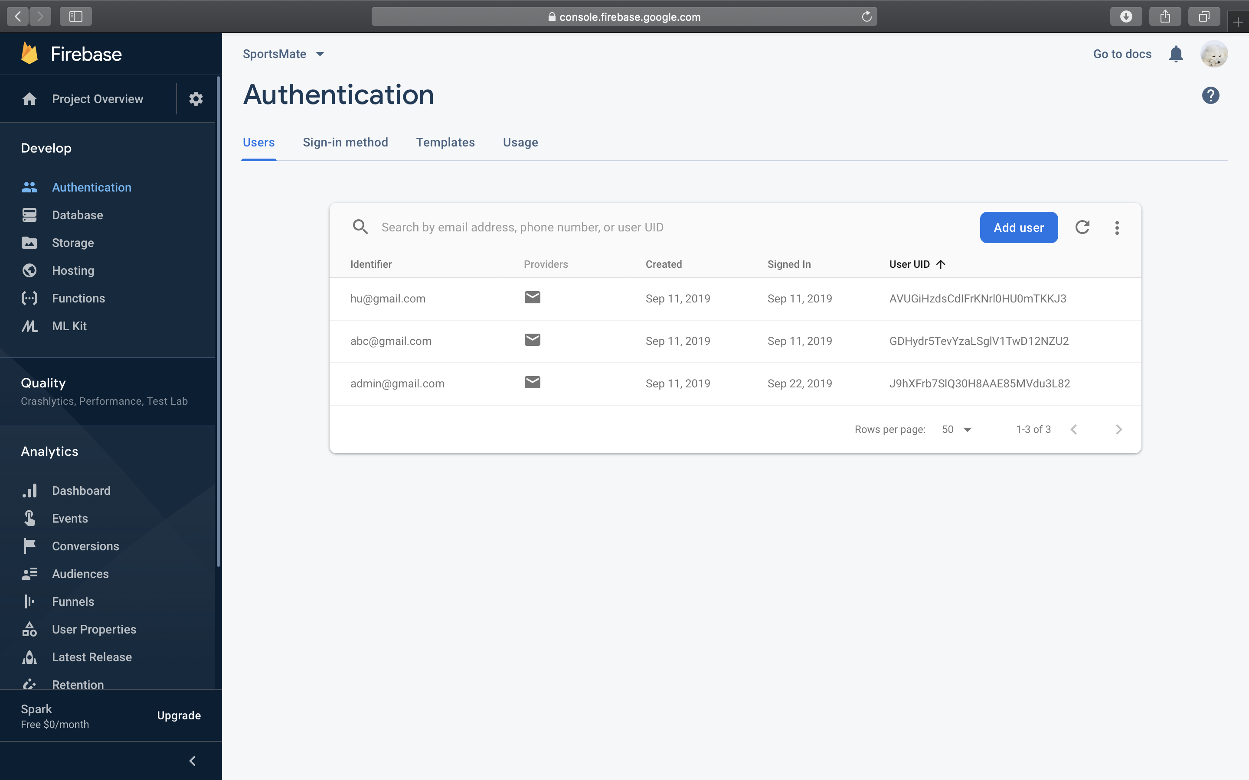
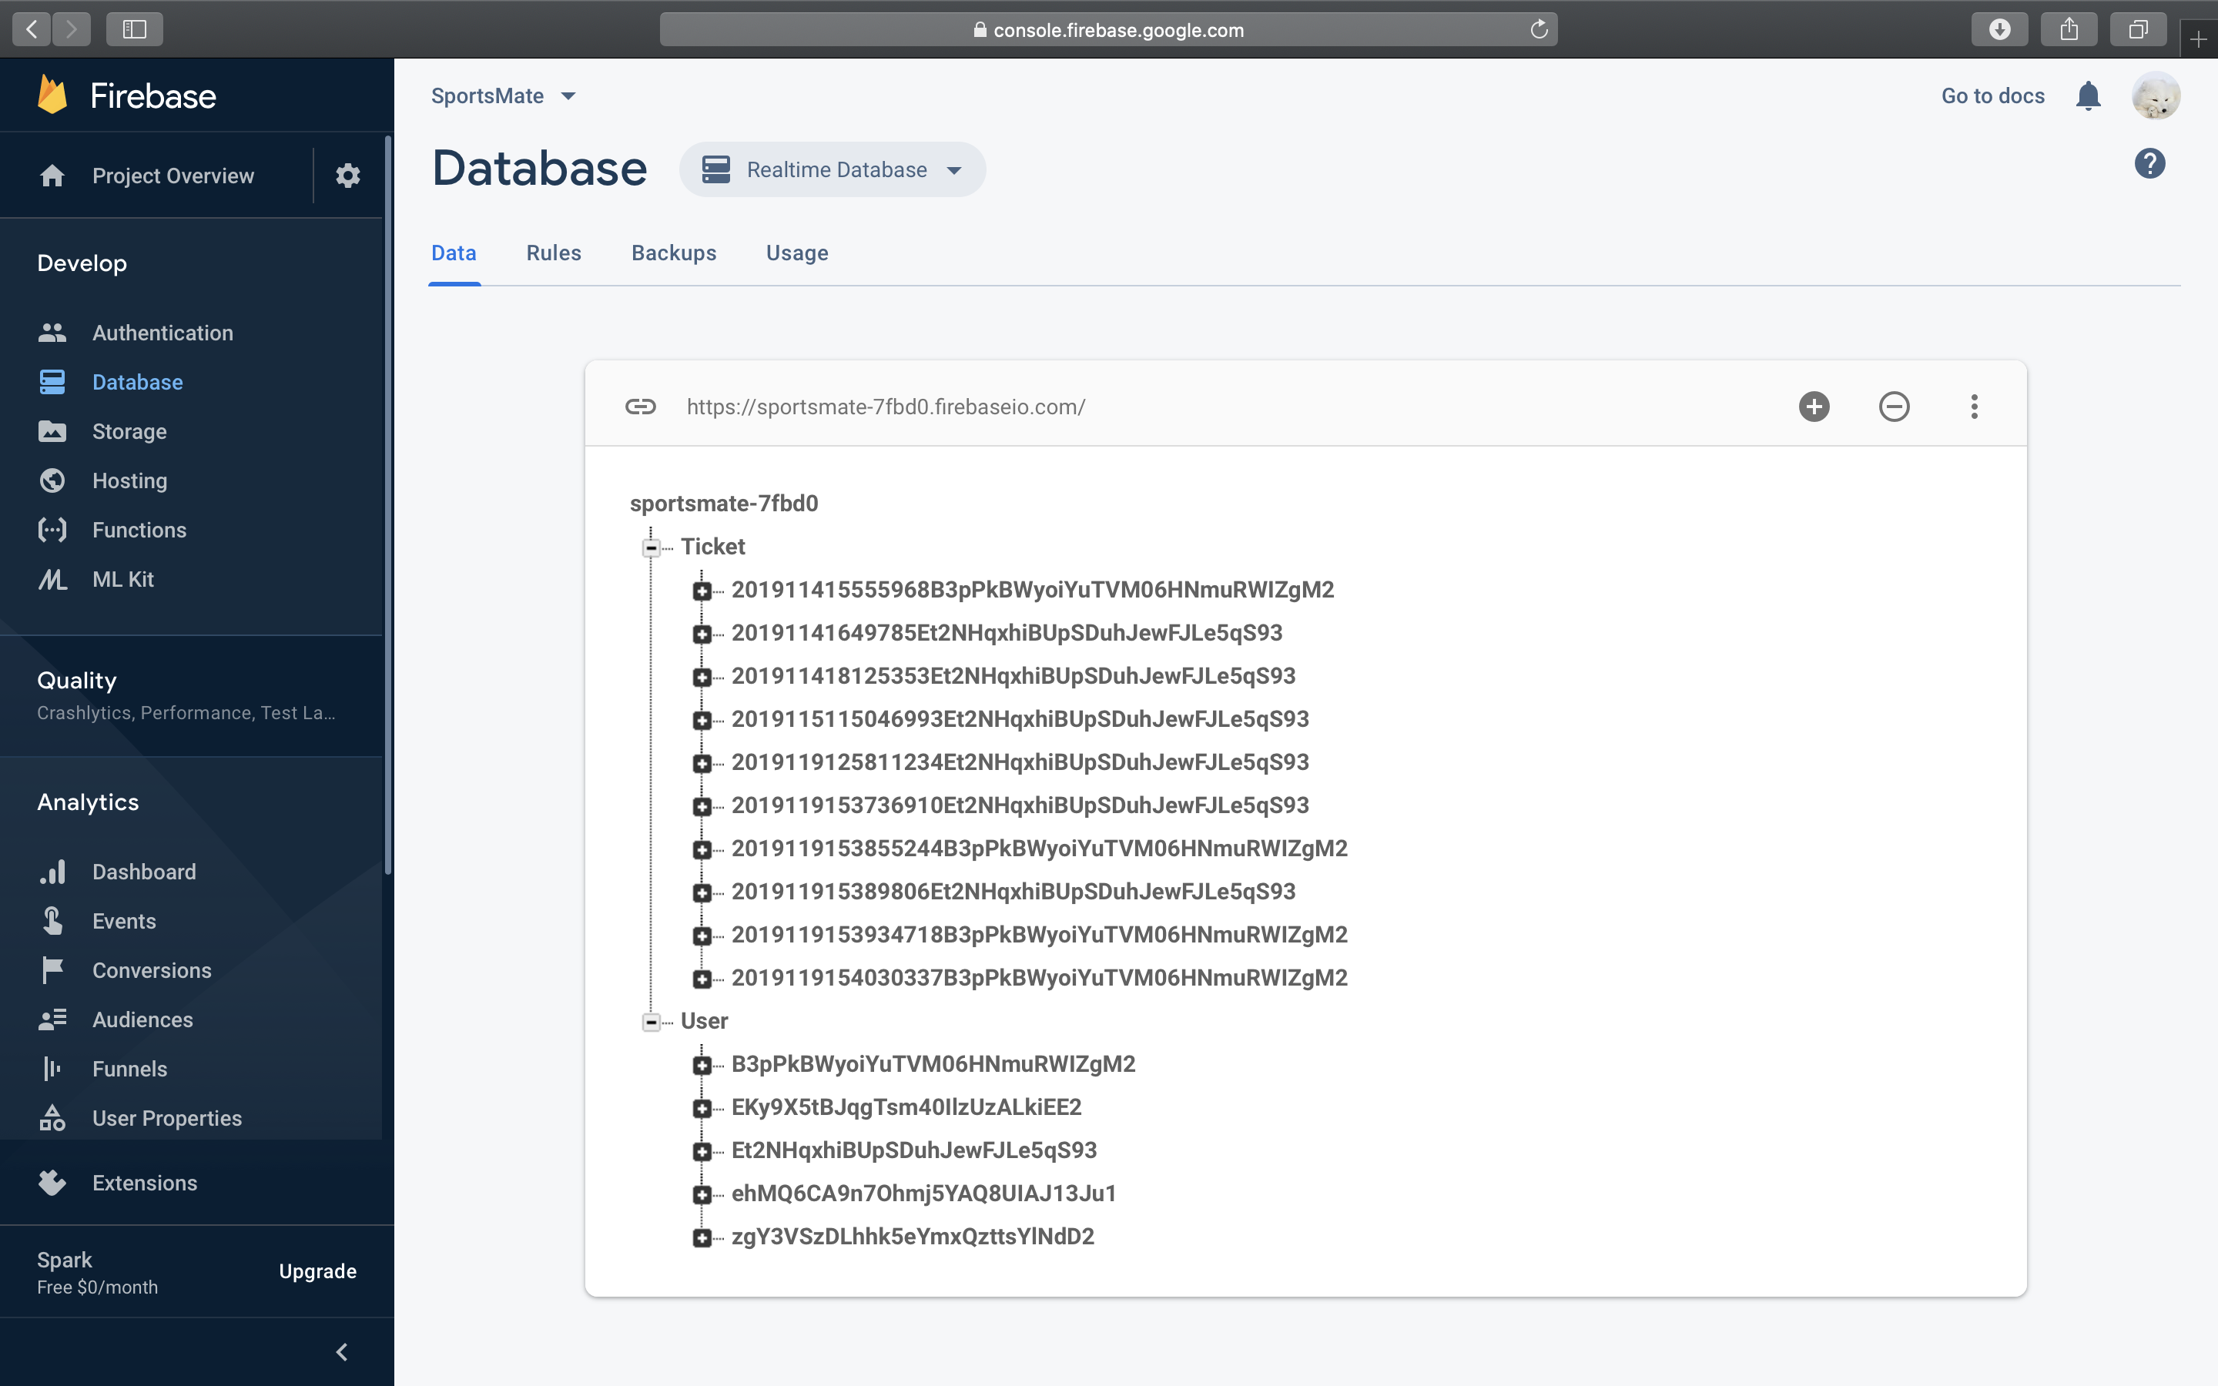
Firebase
Authentication
Database

Slide 7
Class Design
User
String id;
String name;
String gender;
String zipCode;
String badminton;
String basketball;
String tennis;
List<String> ticketID
Ticket
String id;
String sports;
String level;
String zipCode;
String address;
String date;
String time;
List<String> userID;

Slide 8

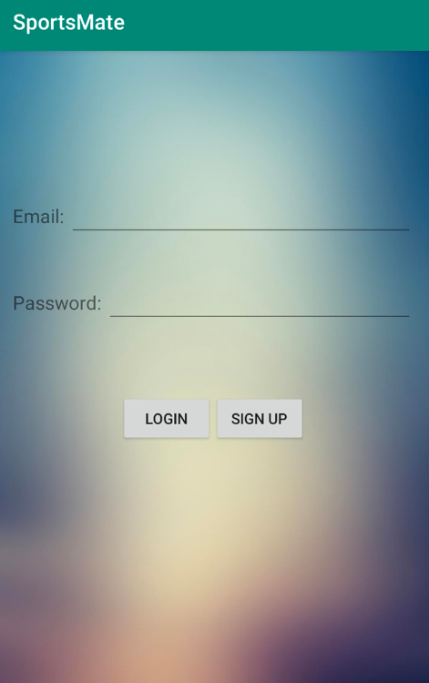
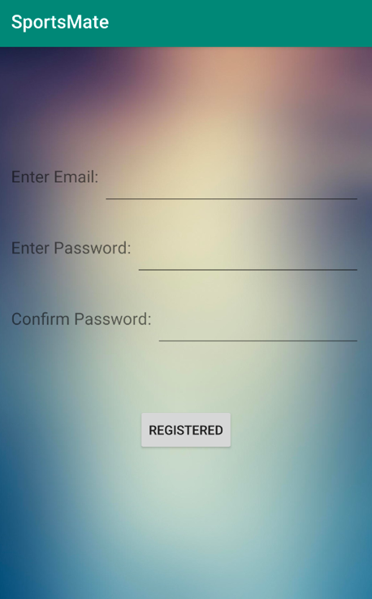
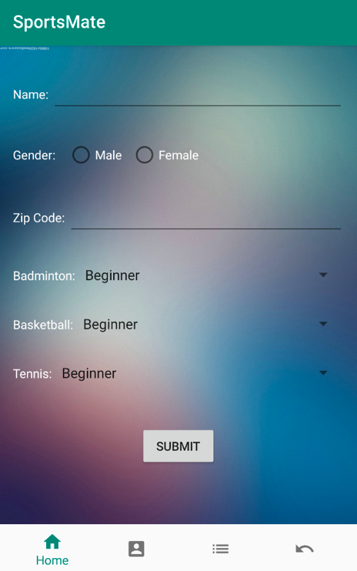
Demo
Welcome
Log In
Register
Create Profile

Slide 9
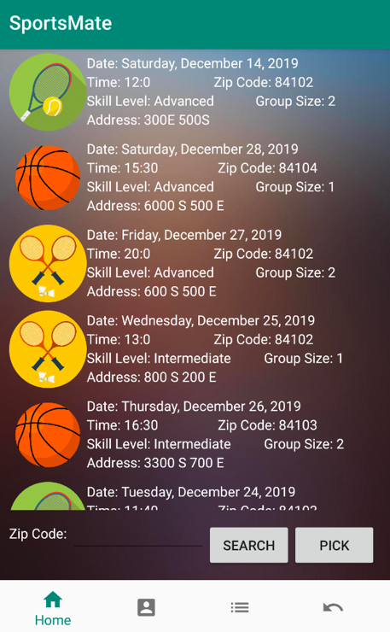
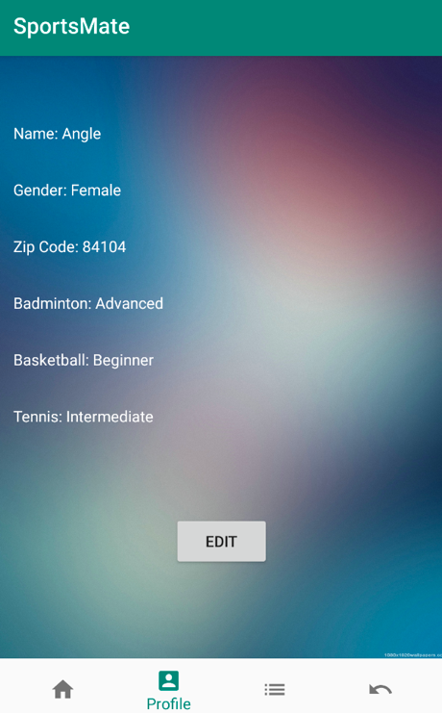
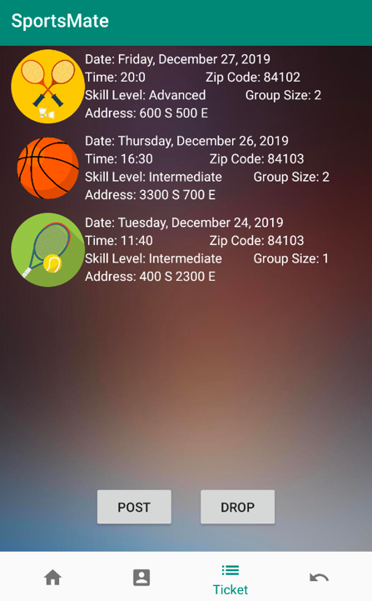
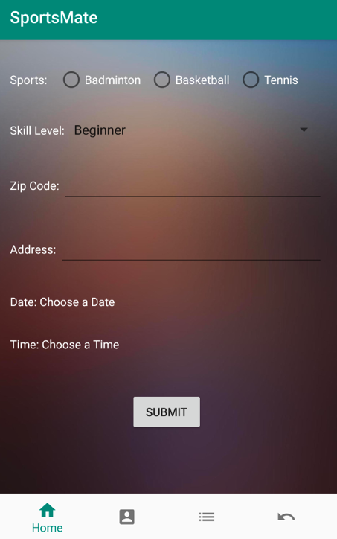
Demo
Home
Profile
Ticket
Post

Slide 10
Questions
Thank You

